Slide 1

COMPUTER NETWORKS
TEAM NETWORKS
Department of Computer Science and Engineering

Slide 2
COMPUTER NETWORKS
Link Layer and LAN
TEAM NETWORKS
Department of Computer Science and Engineering

Slide 3
COMPUTER NETWORKS
Unit – 4 Link Layer and LAN Roadmap
Introduction
Error detection, correction
Multiple access protocols
LANs
addressing, ARP
Ethernet
switches
A day in the life of a web request
Physical layer
Wireless LANs: IEEE 802.11

Slide 4
COMPUTER NETWORKS
Unit – 4 Link Layer and LAN Roadmap
Introduction
Error detection, correction
Multiple access protocols
LANs
addressing, ARP
Ethernet
switches
A day in the life of a web request
Physical layer
Wireless LANs: IEEE 802.11

Slide 5















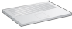
COMPUTER NETWORKS
Introduction to Link layer
mobile network
Terminology:
Hosts, routers, switches, WiFi access points: Nodes
communication channels that connect adjacent nodes along communication path: Links
wired
wireless
layer-2 packet: frame, encapsulates datagram
national or global ISP
datacenter
network
enterprise
network
link layer has responsibility of
transferring datagram from one node to physically adjacent node over a link

Slide 6
COMPUTER NETWORKS
Link Layer: Context
Datagram transferred by different link protocols over different links:
e.g., WiFi on first link, Ethernet on next link
Each link protocol provides different services
e.g., may or may not provide reliable data transfer over link
transportation analogy:
trip from Princeton to Lausanne
limousine: Princeton to JFK airport
plane: JFK to Geneva
train: Geneva to Lausanne
tourist = datagram
transport segment = communication link
transportation mode = link-layer protocol
travel agent = routing algorithm

Slide 7
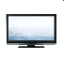

COMPUTER NETWORKS
Link Layer: Services
…
framing, link access:
encapsulate datagram into frame, adding header, trailer
channel access if shared medium
“MAC” addresses in frame headers identify source, destination (different from IP address!)
reliable delivery between adjacent nodes
we already know how to do this!
rarely used on low bit-error links (coax, fiber, etc)
wireless links: high error rates
…

Slide 8
COMPUTER NETWORKS
Link Layer: Services
…
flow control:
pacing between adjacent sending and receiving nodes
error detection:
errors caused by signal attenuation, noise.
receiver detects errors, signals retransmission, or drops frame
error correction:
receiver identifies and corrects bit error(s) without retransmission
half-duplex and full-duplex:
with half duplex, nodes at both ends of link can transmit, but not at same time
…

Slide 9
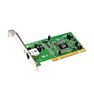
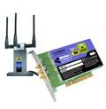

COMPUTER NETWORKS
Where is the link layer implemented?
In each-and-every host
Link layer implemented in network interface card (NIC) or on a chip
Ethernet, WiFi card or chip
implements link, physical layer
Attaches into host’s system buses
Combination of hardware, software, firmware
application
transport
network
link
cpu
memory
host bus
(e.g., PCI)
controller
link
physical
physical
network interface

Slide 10
COMPUTER NETWORKS
Interfaces communicating
application
transport
network
link
application
transport
network
link
cpu
memory
memory
CPU
datagram
link_{h}
datagram
controller
controller
datagram
link_{h}
link
physical
link
physical
physical
physical
Sending side:
encapsulates datagram in frame
adds error checking bits, reliable data transfer, flow control, etc.
Receiving side:
looks for errors, reliable data transfer, flow control, etc.
extracts datagram, passes to upper layer at receiving side

Slide 11
COMPUTER NETWORKS
Unit – 4 Link Layer and LAN Roadmap
Introduction
Error detection, correction
Multiple access protocols
LANs
addressing, ARP
Ethernet
switches
A day in the life of a web request
Physical layer
Wireless LANs: IEEE 802.11

Slide 12
COMPUTER NETWORKS
Error detection
EDC: error detection and correction bits (e.g., redundancy)
D: data protected by error checking, may include header fields
datagram
datagram
Error detection not 100% reliable!
protocol may miss some errors, but rarely
larger EDC field yields better detection and correction
otherwise
all
bits in D’
OK
?
N
detected
error
d data bits
D
EDC
D’
EDC’
bit-error prone link

Slide 13
COMPUTER NETWORKS
Parity checking
single bit parity:
detect single bit errors
two-dimensional bit parity:
detect and correct single bit errors
row parity
0111000110101011
1
d_{1,1}
. . .
d_{1,j}
d_{1,j+1}
d data bits
d_{2,1}
. . .
d_{2,j}
d_{2,j+1}
parity
bit
. . .
. . .
. . .
. . .
d_{i,1}
. . .
d_{i,j}
d_{i,j+1}
column
parity
Even parity: set parity bit so there is an even number of 1’s
d_{i+1,1}
. . .
d_{i+1,j}
d_{i+1,j+1}
detected
and
correctable
single-bit
error:
1 0 1 0 1 1
no errors:
1 0 1 0 1 1
1 0 1 1 0 0
parity
error
1 1 1 1 0 0
0 1 1 1 0 1
0 1 1 1 0 1
1 0 1 0 1 0
0 0 1 0 1 0
parity
error

Slide 14
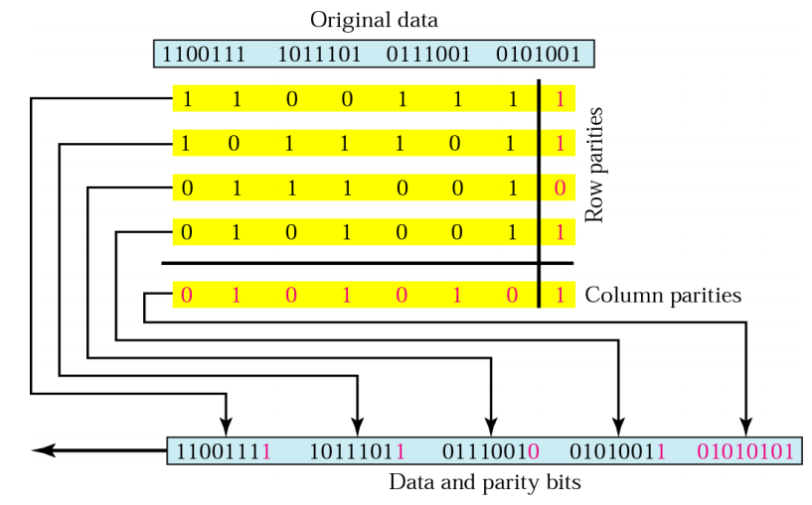
COMPUTER NETWORKS
Two dimensional bit parity check - Example

Slide 15
COMPUTER NETWORKS
Internet checksum (review)
Goal: detect errors (i.e., flipped bits) in transmitted segment
Sender:
treat contents of UDP segment (including UDP header fields and IP addresses) as sequence of 16-bit integers
checksum: addition (one’s complement sum) of segment content
checksum value put into UDP checksum field
Receiver:
compute checksum of received segment
check if computed checksum equals checksum field value:
not equal - error detected
equal - no error detected. But maybe errors nonetheless? More later ….

Slide 16

COMPUTER NETWORKS
Two dimensional bit parity check - Example

Slide 17
COMPUTER NETWORKS
Cyclic Redundancy Check (CRC Codes)
more powerful error-detection coding
D: data bits (given, think of these as a binary number)
G: bit pattern (generator), of r+1 bits (given)
r CRC bits
d data bits
D
R
bit pattern
<D,R> = D 2^{r} XOR R
formula for bit pattern
*
goal: choose r CRC bits, R, such that <D,R> exactly divisible by G (mod 2)
receiver knows G, divides <D,R> by G. If non-zero remainder: error detected!
can detect all burst errors less than r+1 bits
widely used in practice (Ethernet, 802.11 WiFi)

Slide 18
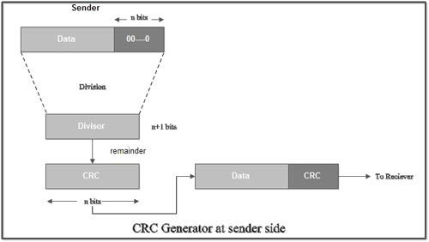
COMPUTER NETWORKS
Sender Side – Calculation of CRC
A string of n 0’s is appended to the data unit to be transmitted.
Here, n is one less than the number of bits in CRC generator.
Binary division is performed of the resultant string with the CRC generator.
After division, the remainder so obtained is called as CRC.
It may be noted that CRC also consists of n bits.

Slide 19
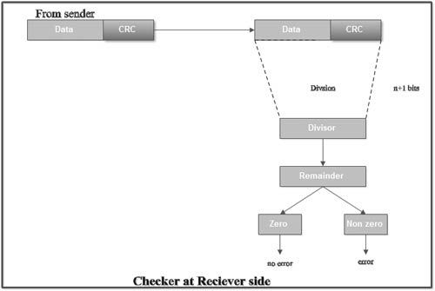
COMPUTER NETWORKS
Receiver Side – Check
The received code word is divided with the same CRC generator.
On division, the remainder so obtained is checked.
Case-1: Remainder = 0,
No error
Receiver accepts the data
Case-2: Remainder ≠ 0
Receiver assumes that some error occurred
Receiver rejects the data and asks the sender for retransmission.

Slide 20
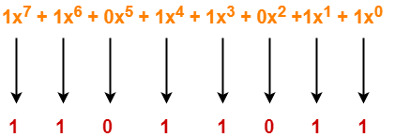
COMPUTER NETWORKS
CRC Generator
an algebraic polynomial represented as a bit pattern
Rule - The power of each term gives the position of the bit and the coefficient gives the value of the bit.
Consider the CRC generator is x⁷ + x⁶ + x⁴ + x³ + x + 1.

Slide 21
COMPUTER NETWORKS
Cyclic Redundancy Check (CRC): Example
Calculation for the case of:
D = 101110, d = 6,
G = 1001, and r = 3.
G
1
0
1
0 1 1
1 0 0 1
1 0 1 1 1 0
0 0 0
1 0 0 1
1 0 1
D
2^{r}
0 0 0
*
1 0 1 0
1 0 0 1
1 1 0
0 0 0
1 1 0 0
1 0 0 1
1 0 1 0
1 0 0 1
0 1 1
R

Slide 22

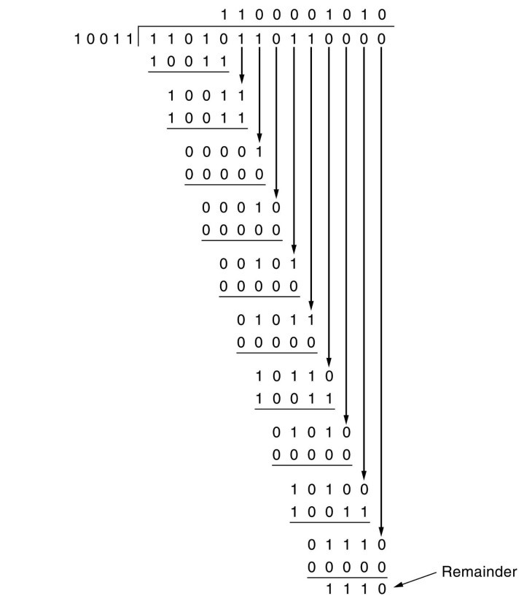

COMPUTER NETWORKS
CRC – Numerical Example
A bit stream 1101011011 is transmitted using the standard CRC method. The generator polynomial is x⁴+x+1.
What is the actual bit string transmitted?
Solution
Generator polynomial G(x) = x⁴ + x + 1 is encoded as 10011.
G(x) consists of 5 bits. So, a string of 4 zeroes is appended to the bit stream to be transmitted.
The resulting bit stream is 11010110110000.

Slide 23
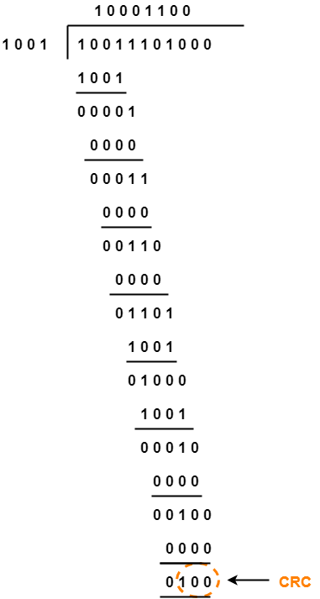
COMPUTER NETWORKS
CRC – Numerical Example
A bit stream 10011101 is transmitted using the standard CRC method. The generator polynomial is x³+1.
What is the actual bit string transmitted?
Suppose the third bit from the left is inverted during transmission. How will receiver detect this error?
Solution
Generator polynomial G(x) = x³ + 1 is encoded as 1001.
G(x) consists of 4 bits. 4 zeroes is appended now.
The resulting bit stream is 10011101000.
Solution (Part-1)
Code word to be transmitted is obtained by replacing the last 3 zeroes of 10011101000 with the CRC.
Code word transmitted to the receiver = 10011101100.

Slide 24
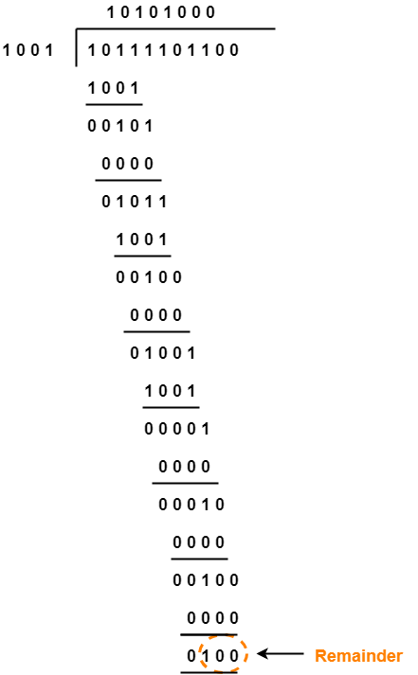
COMPUTER NETWORKS
CRC – Numerical Example
Solution (Part-2)
According to the question,
The bit stream received by the receiver = 10111101100.
Receiver performs the binary division with the same G(x).
Remainder obtained on division is a non-zero value.
Error occurred

Slide 25
COMPUTER NETWORKS
Unit – 4 Link Layer and LAN Roadmap
Introduction
Error detection, correction
Multiple access protocols
LANs
addressing, ARP
Ethernet
switches
A day in the life of a web request
Physical layer
Wireless LANs: IEEE 802.11

Slide 26



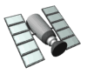
COMPUTER NETWORKS
Multiple access links, Protocols
two types of “links”:
point-to-point
point-to-point link between Ethernet switch, host
PPP, HDLC
broadcast (shared wire or medium)
old-fashioned Ethernet
upstream HFC in cable-based access network
802.11 wireless LAN, 4G/4G, satellite
As humans, we’ve evolved an elaborate set of protocols for sharing the broadcast channel:
“Give everyone a chance to speak.”
“Don’t speak until you are spoken to.”
“Don’t monopolize the conversation.”
“Raise your hand if you have a question.”
“Don’t interrupt when someone is speaking.”
“Don’t fall asleep when someone is talking.”
shared wire (e.g.,
cabled Ethernet)
shared radio: 4G/5G
shared radio: WiFi
shared radio: satellite
humans at a cocktail party
(shared air, acoustical)

Slide 27
COMPUTER NETWORKS
Multiple access protocols
Single shared broadcast channel
Two or more simultaneous transmissions by nodes: interference
collision if node receives two or more signals at the same time
Multiple access protocol
Distributed algorithm that determines how nodes share channel, i.e., determine when node can transmit
Communication about channel sharing must use channel itself!
no out-of-band channel for coordination

Slide 28
COMPUTER NETWORKS
An ideal Multiple access protocol
Given: multiple access channel (MAC) of rate R bps
desiderata(needed):
1. when one node wants to transmit, it can send at rate R.
2. when M nodes want to transmit, each can send at average rate R/M
3. fully decentralized:
no special node to coordinate transmissions
no synchronization of clocks, slots
4. simple

Slide 29
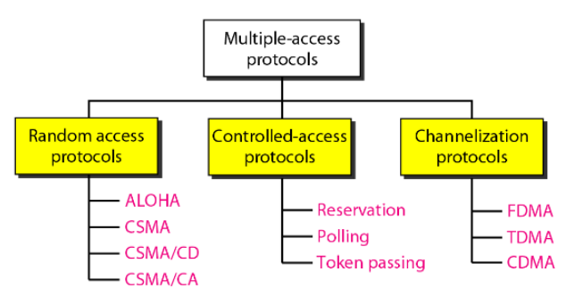
COMPUTER NETWORKS
MAC protocols : Taxonomy
Three broad classes:
channel partitioning (TDMA, FDMA, CDMA)
divide channel into smaller “pieces” (time slots, frequency, code)
allocate piece to node for exclusive use
random access (ALOHA, slotted ALOHA, CSMA, CSMA/CD, CSMA/CA
channel not divided, allow collisions
“recover” from collisions
“taking turns”
nodes take turns, but nodes with more to send can take longer turns
Included in the syllabus

Slide 30
COMPUTER NETWORKS
CSMA (Carrier Sense Multiple Access)
Simple CSMA: listen before transmit:
if channel sensed idle: transmit entire frame
if channel sensed busy: defer transmission
Human analogy: don’t interrupt others!
Listen before speaking – Carrier Sensing
If someone else begins talking at the same time, stop talking – Collision Detection
CSMA/CD: CSMA with collision detection
collisions detected within short time
colliding transmissions aborted, reducing channel wastage
collision detection easy in wired, difficult with wireless
human analogy: the polite conversationalist

Slide 31
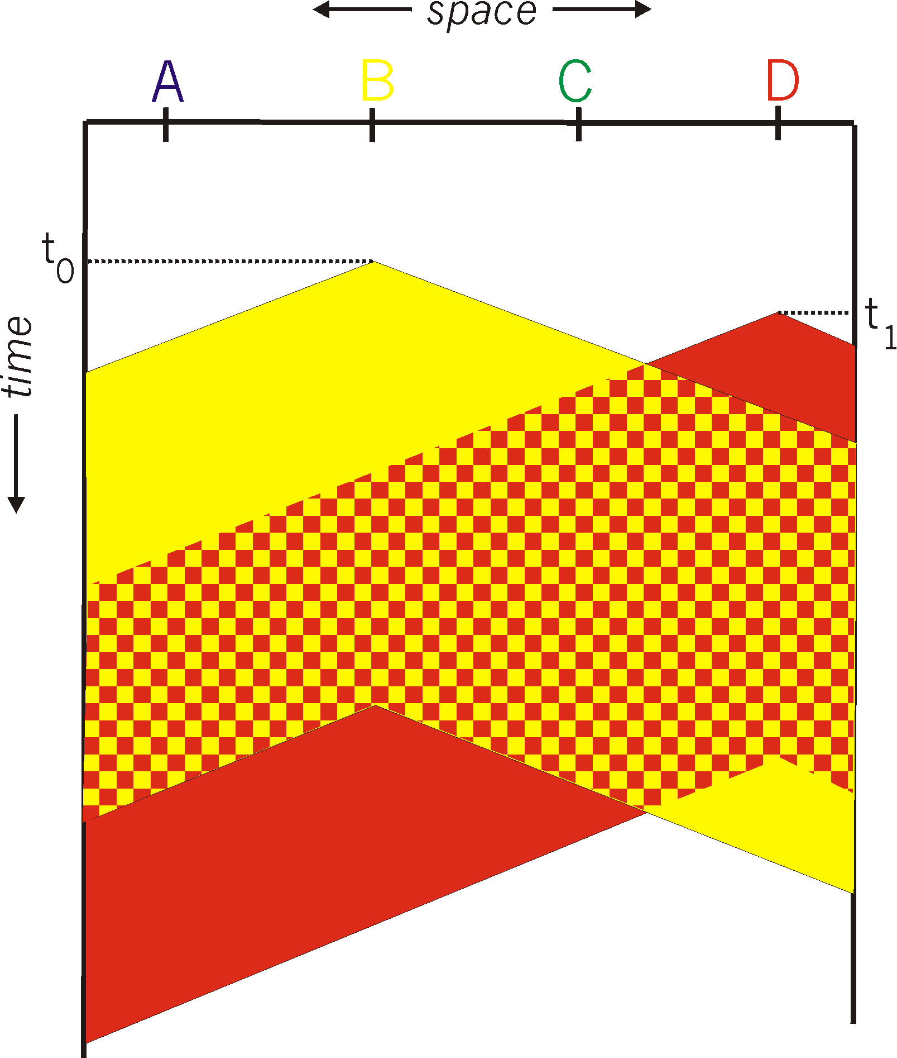
COMPUTER NETWORKS
CSMA Collisions
spatial layout of nodes
collisions can still occur with carrier sensing:
propagation delay means two nodes may not hear each other’s just-started transmission
collision: entire packet transmission time wasted
distance & propagation delay play role in in determining collision probability

Slide 32
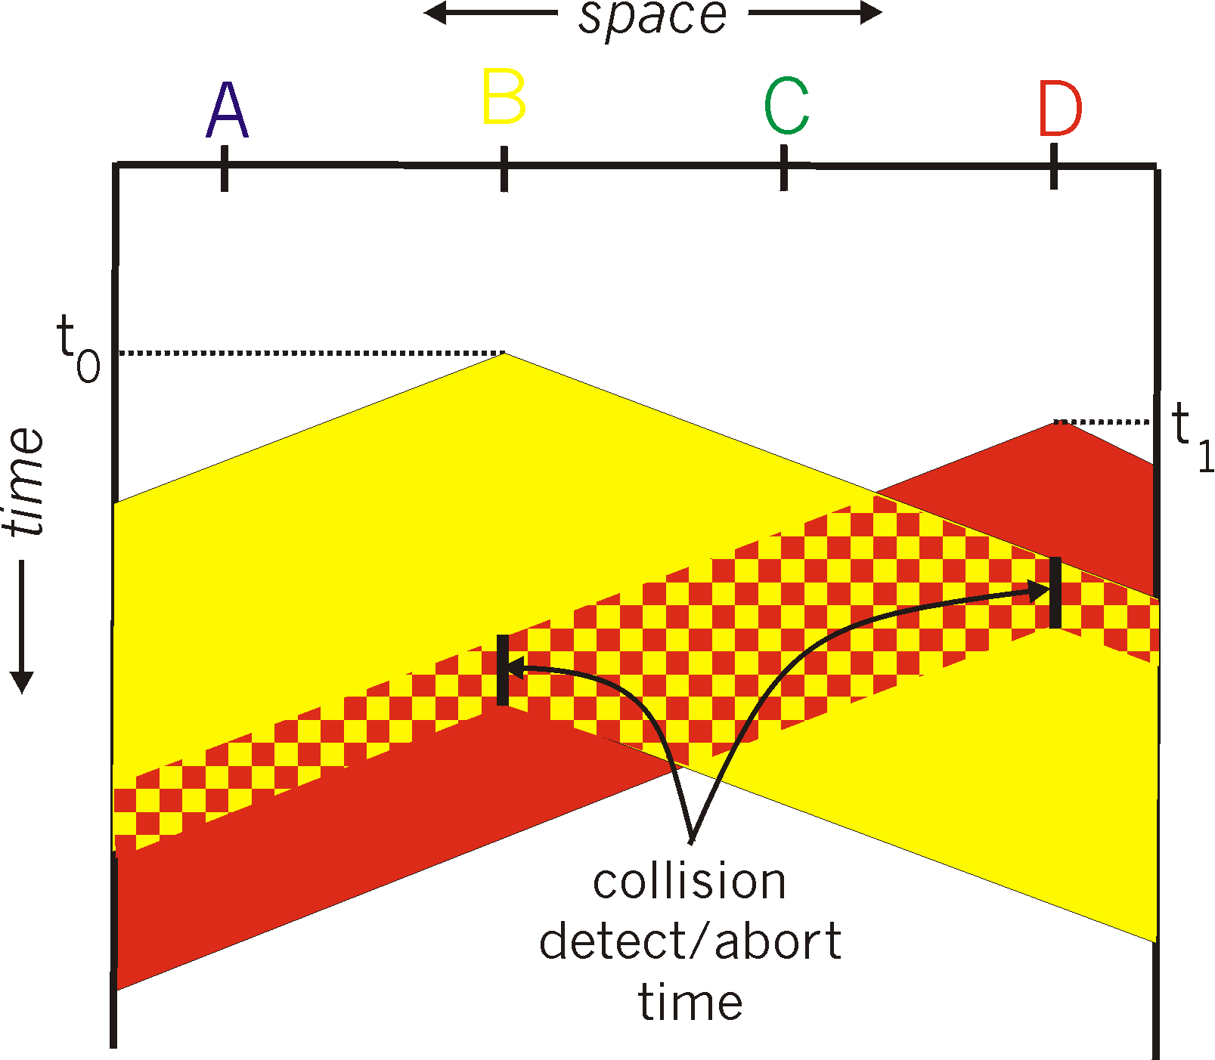
COMPUTER NETWORKS
CSMA/CD
spatial layout of nodes
CSMA/CS reduces the amount of time wasted in collisions
transmission aborted on collision detection

Slide 33
COMPUTER NETWORKS
Ethernet CSMA/CD Algorithm
NIC receives datagram from network layer, creates frame
If NIC senses channel:
if idle: start frame transmission.
if busy: wait until channel idle, then transmit
If NIC transmits entire frame without collision, NIC is done with frame!
If NIC detects another transmission while sending: abort, send jam signal
After aborting, NIC enters binary (exponential) backoff:
after n collisions, NIC chooses K at random from {0,1,2, …, 2^{m}-1}.
NIC waits K·512 bit times, returns to Step 2
more collisions: longer backoff interval

Slide 34
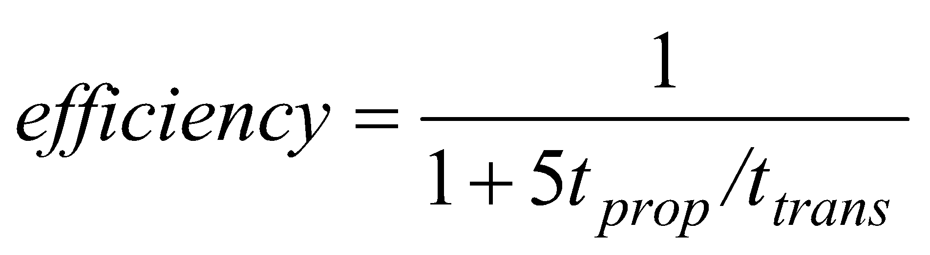
COMPUTER NETWORKS
CSMA (Carrier Sense Multiple Access)
T_{prop} = max prop delay between 2 nodes in LAN
t_{trans} = time to transmit max-size frame
efficiency goes to 1
as t_{prop} goes to 0
as t_{trans} goes to infinity
better performance than ALOHA: and simple, cheap, decentralized!

Slide 35
COMPUTER NETWORKS
Unit – 4 Link Layer and LAN Roadmap
Introduction
Error detection, correction
Multiple access protocols
Switched LANs
LL addressing, ARP
Ethernet
switches
A day in the life of a web request
Physical layer
Wireless LANs: IEEE 802.11

Slide 36
COMPUTER NETWORKS
MAC Addresses
32-bit IP address:
network-layer address for interface
used for layer 3 (network layer) forwarding
e.g.: 128.119.40.136
MAC (or LAN or physical or Ethernet) address:
function: used “locally” to get frame from one interface to another physically-connected interface (same subnet, in IP-addressing sense)
48-bit MAC address (for most LANs) burned in NIC ROM, also sometimes software settable
e.g.: 1A-2F-BB-76-09-AD
hexadecimal (base 16) notation
(each “numeral” represents 4 bits)

Slide 37
COMPUTER NETWORKS
MAC Addresses
Each interface on LAN
has unique 48-bit MAC address
has a locally unique 32-bit IP address (as we’ve seen)
137.196.7.78
1A-2F-BB-76-09-AD
LAN
(wired or wireless)
137.196.7/24
71-65-F7-2B-08-53
58-23-D7-FA-20-B0
137.196.7.23
137.196.7.14
0C-C4-11-6F-E3-98
137.196.7.88

Slide 38
COMPUTER NETWORKS
MAC Addresses
MAC address allocation administered by IEEE
manufacturer buys portion of MAC address space (to assure uniqueness)
analogy:
MAC address: like Social Security Number
IP address: like postal address
MAC flat address: portability
can move interface from one LAN to another
recall IP address not portable: depends on IP subnet to which node is attached

Slide 39
COMPUTER NETWORKS
ARP: Address Resolution Protocol
Question: how to determine interface’s MAC address, knowing its IP address?
ARP table: each IP node (host, router) on LAN has table
ARP
IP/MAC address mappings for some LAN nodes:
< IP address; MAC address; TTL>
TTL (Time To Live): time after which address mapping will be forgotten (typically 20 min)
137.196.7.78
1A-2F-BB-76-09-AD
ARP
ARP
LAN
71-65-F7-2B-08-53
58-23-D7-FA-20-B0
137.196.7.23
137.196.7.14
ARP
0C-C4-11-6F-E3-98
137.196.7.88

Slide 40
COMPUTER NETWORKS
ARP Protocol in action
Example: A wants to send datagram to B
B’s MAC address not in A’s ARP table, so A uses ARP to find B’s MAC address
A broadcasts ARP query, containing B's IP addr
destination MAC address = FF-FF-FF-FF-FF-FF
all nodes on LAN receive ARP query
1
Ethernet frame (sent to FF-FF-FF-FF-FF-FF)
C
Source MAC: 71-65-F7-2B-08-53
Source IP: 137.196.7.23
Target IP address: 137.196.7.14
…
ARP table in A
IP addr
MAC addr
TTL
TTL
A
B
1
71-65-F7-2B-08-53
58-23-D7-FA-20-B0
137.196.7.23
137.196.7.14
D

Slide 41
COMPUTER NETWORKS
ARP Protocol in action
Example: A wants to send datagram to B
B’s MAC address not in A’s ARP table, so A uses ARP to find B’s MAC address
ARP message into Ethernet frame (sent to 71-65-F7-2B-08-53)
C
Target IP address: 137.196.7.14
Target MAC address:
58-23-D7-FA-20-B0
…
ARP table in A
IP addr
MAC addr
TTL
TTL
A
B
2
71-65-F7-2B-08-53
58-23-D7-FA-20-B0
137.196.7.23
137.196.7.14
2
B replies to A with ARP response, giving its MAC address
D

Slide 42
COMPUTER NETWORKS
ARP Protocol in action
Example: A wants to send datagram to B
B’s MAC address not in A’s ARP table, so A uses ARP to find B’s MAC address
C
ARP table in A
IP addr
MAC addr
TTL
TTL
A
B
137.196.
7.14
58-23-D7-FA-20-B0
500
71-65-F7-2B-08-53
58-23-D7-FA-20-B0
137.196.7.23
137.196.7.14
3
A receives B’s reply, adds B entry into its local ARP table
D

Slide 43

COMPUTER NETWORKS
Routing to another Subnet : Addressing
Walkthrough: sending a datagram from A to B via R
Focus on addressing – at IP (datagram) and MAC layer (frame) levels
Assume that:
A knows B’s IP address
A knows IP address of first hop router, R (how?)
A knows R’s MAC address (how?)
A
R
B
111.111.111.111
74-29-9C-E8-FF-55
222.222.222.222
49-BD-D2-C7-56-2A
222.222.222.220
1A-23-F9-CD-06-9B
111.111.111.112
111.111.111.110
CC-49-DE-D0-AB-7D
E6-E9-00-17-BB-4B
222.222.222.221
88-B2-2F-54-1A-0F

Slide 44
COMPUTER NETWORKS
Routing to another Subnet : Addressing
A creates IP datagram with IP source A, destination B
A creates link-layer frame containing A-to-B IP datagram
R's MAC address is frame’s destination
MAC src: 74-29-9C-E8-FF-55
MAC dest: E6-E9-00-17-BB-4B
IP
Eth
Phy
IP src: 111.111.111.111
IP dest: 222.222.222.222
A
R
B
111.111.111.111
74-29-9C-E8-FF-55
222.222.222.222
49-BD-D2-C7-56-2A
222.222.222.220
1A-23-F9-CD-06-9B
111.111.111.112
111.111.111.110
CC-49-DE-D0-AB-7D
E6-E9-00-17-BB-4B
222.222.222.221
88-B2-2F-54-1A-0F

Slide 45
COMPUTER NETWORKS
Routing to another Subnet : Addressing
frame sent from A to R
frame received at R, datagram removed, passed up to IP
MAC src: 74-29-9C-E8-FF-55
MAC dest: E6-E9-00-17-BB-4B
IP src: 111.111.111.111
IP dest: 222.222.222.222
IP
Eth
Phy
IP src: 111.111.111.111
IP dest: 222.222.222.222
IP
Eth
Phy
A
R
B
111.111.111.111
74-29-9C-E8-FF-55
222.222.222.222
49-BD-D2-C7-56-2A
222.222.222.220
1A-23-F9-CD-06-9B
111.111.111.112
111.111.111.110
CC-49-DE-D0-AB-7D
E6-E9-00-17-BB-4B
222.222.222.221
88-B2-2F-54-1A-0F

Slide 46
COMPUTER NETWORKS
Routing to another Subnet : Addressing
R determines outgoing interface, passes datagram with IP source A, destination B to link layer
R creates link-layer frame containing A-to-B IP datagram. Frame destination address: B's MAC address
MAC src: 1A-23-F9-CD-06-9B
MAC dest: 49-BD-D2-C7-56-2A
IP
Eth
Phy
IP src: 111.111.111.111
IP dest: 222.222.222.222
A
R
B
111.111.111.111
74-29-9C-E8-FF-55
222.222.222.222
49-BD-D2-C7-56-2A
222.222.222.220
1A-23-F9-CD-06-9B
111.111.111.112
111.111.111.110
CC-49-DE-D0-AB-7D
E6-E9-00-17-BB-4B
222.222.222.221
88-B2-2F-54-1A-0F

Slide 47
COMPUTER NETWORKS
Routing to another Subnet : Addressing
R determines outgoing interface, passes datagram with IP source A, destination B to link layer
R creates link-layer frame containing A-to-B IP datagram. Frame destination address: B's MAC address
MAC src: 1A-23-F9-CD-06-9B
MAC dest: 49-BD-D2-C7-56-2A
Transmits link-layer frame
IP
Eth
Phy
IP
Eth
Phy
IP src: 111.111.111.111
IP dest: 222.222.222.222
A
R
B
111.111.111.111
74-29-9C-E8-FF-55
222.222.222.222
49-BD-D2-C7-56-2A
222.222.222.220
1A-23-F9-CD-06-9B
111.111.111.112
111.111.111.110
CC-49-DE-D0-AB-7D
E6-E9-00-17-BB-4B
222.222.222.221
88-B2-2F-54-1A-0F

Slide 48
COMPUTER NETWORKS
Routing to another Subnet : Addressing
B receives frame, extracts IP datagram destination B
B passes datagram up protocol stack to IP
IP src: 111.111.111.111
IP dest: 222.222.222.222
IP
Eth
Phy
IP
Eth
Phy
A
R
B
111.111.111.111
74-29-9C-E8-FF-55
222.222.222.222
49-BD-D2-C7-56-2A
222.222.222.220
1A-23-F9-CD-06-9B
111.111.111.112
111.111.111.110
CC-49-DE-D0-AB-7D
E6-E9-00-17-BB-4B
222.222.222.221
88-B2-2F-54-1A-0F

Slide 49
COMPUTER NETWORKS
Unit – 4 Link Layer and LAN Roadmap
Introduction
Error detection, correction
Multiple access protocols
Switched LANs
LL addressing, ARP
Ethernet
switches
A day in the life of a web request
Physical layer
Wireless LANs: IEEE 802.11

Slide 50
COMPUTER NETWORKS
Ethernet
“dominant” wired LAN technology:
first widely used LAN technology
simpler, cheap
kept up with speed race: 10 Mbps – 400 Gbps
single chip, multiple speeds (e.g., Broadcom BCM5761)
Ethernet’ Success
First widely deployed high-speed LAN
Token ring, FDDI, and ATM were more complex and expensive than Ethernet
Operated at equal data rates or higher.

Slide 51
COMPUTER NETWORKS
Ethernet : Physical Topology
Bus: popular through mid 90s
all nodes in same collision domain (can collide with each other)
Switched: prevails today
active link-layer 2 switch in center
each “spoke” runs a (separate) Ethernet protocol (nodes do not collide with each other)
bus: coaxial cable
switched

Slide 52
COMPUTER NETWORKS
Ethernet Frame Structure
Sending interface encapsulates IP datagram (or other network layer protocol packet) in Ethernet frame
type
preamble
dest.
address
source
address
data (payload)
CRC
Preamble:
Used to synchronize receiver, sender clock rates
7 bytes of 10101010 followed by one byte of 10101011

Slide 53
COMPUTER NETWORKS
Ethernet Frame Structure ( more)
type
preamble
dest.
address
source
address
data (payload)
CRC
Addresses: 6 byte source, destination MAC addresses
if adapter receives frame with matching destination address, or with broadcast address (e.g., ARP packet), it passes data in frame to network layer protocol
otherwise, adapter discards frame
Type: indicates higher layer protocol
mostly IP but others possible, e.g., Novell IPX, AppleTalk
used to demultiplex up at receiver
CRC: cyclic redundancy check at receiver
error detected: frame is dropped

Slide 54
COMPUTER NETWORKS
Ethernet : Unreliable Connectionless
Connectionless: no handshaking between sending and receiving NICs
Unreliable: receiving NIC doesn’t send ACKs or NAKs to sending NIC
data in dropped frames recovered only if initial sender uses higher layer rdt (e.g., TCP), otherwise dropped data lost
Ethernet’s MAC protocol: unslotted CSMA/CD with binary backoff

Slide 55
COMPUTER NETWORKS
802.3 Ethernet Standards: Link and Physical Layers
Many different Ethernet standards
Common MAC protocol and frame format
Different speeds: 2 Mbps, 10 Mbps, 100 Mbps, 1Gbps, 10 Gbps, 40 Gbps
Different physical layer media: fiber, cable
application
transport
network
link
physical
MAC protocol
and frame format
100BASE-TX
100BASE-T2
100BASE-FX
100BASE-T4
100BASE-SX
100BASE-BX
copper (twister pair) physical layer
fiber physical layer

Slide 56
COMPUTER NETWORKS
Unit – 4 Link Layer and LAN Roadmap
Introduction
Error detection, correction
Multiple access protocols
Switched LANs
Addressing, ARP
Ethernet
Switches
A day in the life of a web request
Physical layer
Wireless LANs: IEEE 802.11

Slide 57
COMPUTER NETWORKS
Ethernet switch
Switch is a link-layer device: takes an active role
Store, forward Ethernet frames
Examine incoming frame’s MAC address, selectively forward frame to one-or-more outgoing links when frame is to be forwarded on segment, uses CSMA/CD to access segment
Transparent: hosts unaware of presence of switches
Plug-and-play, self-learning
Switches do not need to be configured

Slide 58
COMPUTER NETWORKS
Switch : Multiple Simultaneous Transmissions
Hosts have dedicated, direct connection to switch
Switches buffer packets
Ethernet protocol used on each incoming link, so:
no collisions; full duplex
each link is its own collision domain
A
C’
B
1
2
6
3
5
4
B’
C
A’
Switching: A-to-A’ and B-to-B’ can transmit simultaneously, without collisions
switch with six interfaces (1,2,3,4,5,6)

Slide 59

COMPUTER NETWORKS
Switch: Multiple Simultaneous Transmissions
Hosts have dedicated, direct connection to switch
Switches buffer packets
Ethernet protocol used on each incoming link, so:
No collisions; full duplex
Each link is its own collision domain
A
C’
B
1
2
6
3
5
4
B’
C
A’
Switching: A-to-A’ and B-to-B’ can transmit simultaneously, without collisions
but A-to-A’ and C to A’ can not happen simultaneously
switch with six interfaces (1,2,3,4,5,6)

Slide 60
COMPUTER NETWORKS
Switch Forwarding Table
Q: How does switch know A’ reachable via interface 4, B’ reachable via interface 5?
A
C’
B
A: Each switch has a switch table, each entry:
(MAC address of host, interface to reach host, time stamp)
looks like a routing table!
1
2
6
3
5
4
B’
C
A’
Q: How are entries created, maintained in switch table?
something like a routing protocol?

Slide 61
COMPUTER NETWORKS
Switch: Self-learning
Source: A
Dest: A’
Switch learns which hosts can be reached through which interfaces
A A’
A
C’
B
When frame received, switch “learns” location of sender: incoming LAN segment
1
2
6
3
5
4
Records sender/location pair in switch table
B’
C
A’
Switch table
(initially empty)
MAC addr interface TTL
A
1
60

Slide 62
COMPUTER NETWORKS
Switch: Frame Filtering / Forwarding
When frame received at switch:
1. Record incoming link, MAC address of sending host
2. Index switch table using MAC destination address
3. If entry found for destination then {
If destination on segment from which frame arrived then drop frame
else forward frame on interface indicated by entry
}
else flood /* forward on all interfaces except arriving interface */

Slide 63
COMPUTER NETWORKS
Self-learning, Forwarding: Example
Source: A
Dest: A’
Frame destination, A’, location unknown:
A A’
Flood
A
C’
B
Destination A location known:
Selectively send on just one link
1
2
6
A A’
A A’
A A’
A A’
A A’
3
5
4
B’
C
switch table
(initially empty)
A’ A
A’
MAC addr interface TTL
A
1
60
A’
4
60

Slide 64

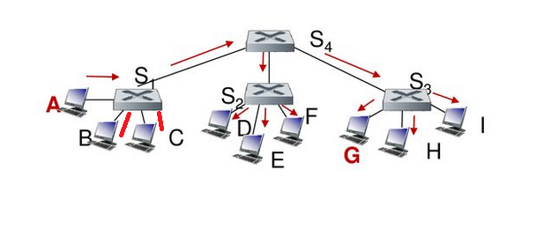

COMPUTER NETWORKS
Interconnecting Switches
Self-learning switches can be connected together:
S₄
S₁
S₃
A
S₂
F
I
B
C
D
E
G
H
Q: sending from A to G - how does S₁ know to forward frame destined to G via S₄ and S₃?
A: self learning! (works exactly the same as in single-switch case!)

Slide 65
COMPUTER NETWORKS
Self-learning Multi-switch Example
Switch 1
Address | Port
C | 1
I | 4
Suppose C sends frame to I, I responds to C
S₄
S₁
Switch 4
Address | Port
C | 1
I | 3
S₃
A
S₂
F
I
B
C
D
E
G
H
Switch 2
Address | Port
C | 4
Q: show switch tables and packet forwarding in S₁, S₂, S₃, S₄
Switch 3
Address | Port
C | 4
I | 3

Slide 66
COMPUTER NETWORKS
Small Institutional Network
mail server
to external
network
router
web server
IP subnet

Slide 67
COMPUTER NETWORKS
Switches Vs Routers
application
transport
network
link
physical
Both are store-and-forward:
Routers: network-layer devices (examine network-layer headers)
Switches: link-layer devices (examine link-layer headers)
datagram
frame
link
physical
frame
switch
Both have forwarding tables:
Routers: compute tables using routing algorithms, IP addresses
Switches: learn forwarding table using flooding, learning, MAC addresses
network
link
physical
datagram
frame
application
transport
network
link
physical

Slide 68
COMPUTER NETWORKS
Unit – 4 Link Layer and LAN Roadmap
Introduction
Error detection, correction
Multiple access protocols
Switched LANs
addressing, ARP
Ethernet
switches
A day in the life of a web request
Physical layer
Wireless LANs: IEEE 802.11

Slide 69
COMPUTER NETWORKS
Synthesis : A day in the life of a web request
Our journey down the protocol stack is now complete!
application, transport, network, link
Putting-it-all-together: synthesis!
Goal: identify, review, understand protocols (at all layers) involved in seemingly simple scenario: requesting www page
Scenario: student attaches laptop to campus network, requests/receives www.google.com

Slide 70



COMPUTER NETWORKS
A day in the life of a web request
Scenario:
DNS server
Arriving mobile client attaches to network …
browser
Comcast network
68.80.0.0/13
Requests web page: www.google.com
school network
68.80.2.0/24
web page
Sounds
simple!
web server
Google’s network
64.233.160.0/19
64.233.169.105

Slide 71
COMPUTER NETWORKS
A day in the life of a web request
DHCP
DHCP
UDP
IP
Eth
Phy
Connecting laptop needs to get its own IP address, addr of first-hop router, addr of DNS server: use DHCP
DHCP
DHCP
DHCP
arriving mobile:
DHCP client
DHCP
DHCP request encapsulated in UDP, encapsulated in IP, encapsulated in 802.3 Ethernet
DHCP
DHCP
UDP
IP
Eth
Phy
DHCP
DHCP
DHCP
Ethernet frame broadcast (dest: FFFFFFFFFFFF) on LAN, received at router running DHCP server
DHCP
router has
DHCP server
Ethernet demuxed to IP demuxed, UDP demuxed to DHCP

Slide 72
COMPUTER NETWORKS
A day in the life : Connecting to the Internet
DHCP
UDP
IP
Eth
Phy
DHCP server formulates DHCP ACK containing client’s IP address, IP address of first-hop router for client, name & IP address of DNS server
DHCP
DHCP
DHCP
arriving mobile:
DHCP client
DHCP
Encapsulation at DHCP server, frame forwarded (switch learning) through LAN, demultiplexing at client
DHCP
DHCP
UDP
IP
Eth
Phy
DHCP
DHCP
DHCP client receives DHCP ACK reply
DHCP
DHCP
router has
DHCP server
Client now has IP address, knows name & addr of DNS
server, IP address of its first-hop router

Slide 73
COMPUTER NETWORKS
A day in the life…. ARP (Before DNS, Before HTTP)
DNS
DNS
UDP
IP
Eth
Phy
Before sending HTTP request, need IP address of www.google.com: DNS
DNS
DNS
ARP
ARP query
arriving mobile:
ARP client
DNS query created, encapsulated in UDP, encapsulated in IP, encapsulated in Eth. To send frame to router, need MAC address of router interface: ARP
ARP query broadcast, received by router, which replies with ARP reply giving MAC address of router interface
ARP
ARP reply
Eth
Phy
router has
ARP server
Client now knows MAC address of first hop router, so can now send frame containing DNS query

Slide 74
DNS
DNS
DNS
COMPUTER NETWORKS
A day in the life…. Using DNS
DNS
DNS
DNS
UDP
IP
Eth
Phy
Demuxed to DNS
DNS replies to client with IP address of www.google.com
DNS
DNS
UDP
IP
Eth
Phy
DNS
DNS
DNS
DNS
DNS
DNS
server
DNS
DNS
Comcast network
68.80.0.0/13
IP datagram containing DNS query forwarded via LAN switch from client to 1st hop router
IP datagram forwarded from campus network into Comcast network, routed (tables created by RIP, OSPF, IS-IS and/or BGP routing protocols) to DNS server

Slide 75
DNS
DNS
DNS
COMPUTER NETWORKS
A day in the life…. TCP Connection carrying HTTP
HTTP
HTTP
TCP
IP
Eth
Phy
To send HTTP request, client first opens TCP socket to web server
SYNACK
SYN
SYNACK
SYN
SYNACK
SYN
SYN
Comcast network
68.80.0.0/13
TCP SYN segment (step 1 in TCP 3-way handshake) inter-domain routed to web server
Web server responds with TCP SYNACK (step 2 in TCP 3-way handshake)
TCP
IP
Eth
Phy
SYNACK
SYN
SYNACK
SYN
TCP connection established!
SYNACK
SYNACK
SYN
Google web server
64.233.169.105

Slide 76
DNS
DNS
DNS
COMPUTER NETWORKS
A day in the life…. HTTP Request / Reply
HTTP
HTTP
TCP
IP
Eth
Phy
HTTP request sent into TCP socket
HTTP
HTTP
HTTP
web page finally (!!!) displayed
HTTP
HTTP
HTTP
IP datagram containing HTTP request routed to www.google.com
HTTP
HTTP
Comcast network
68.80.0.0/13
Web server responds with HTTP reply (containing web page)
HTTP
HTTP
TCP
IP
Eth
Phy
HTTP
IP datagram containing HTTP reply routed back to client
HTTP
HTTP
HTTP
Google web server
64.233.169.105

Slide 77
COMPUTER NETWORKS
Unit – 4 Link Layer and LAN Roadmap
Introduction
Error detection, correction
Multiple access protocols
Switched LANs
addressing, ARP
Ethernet
switches
A day in the life of a web request
Physical layer
Wireless LANs: IEEE 802.11

Slide 78
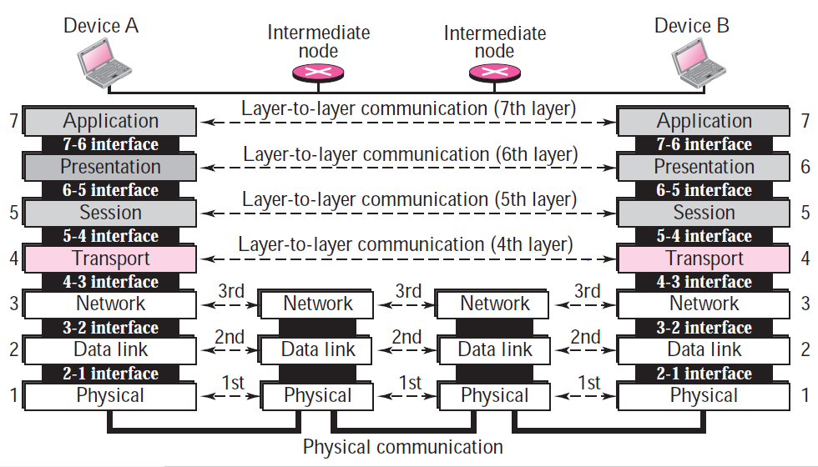
COMPUTER NETWORKS
Physical Layer – OSI Reference Model
Implemented in Software
Implemented in Hardware

Slide 79
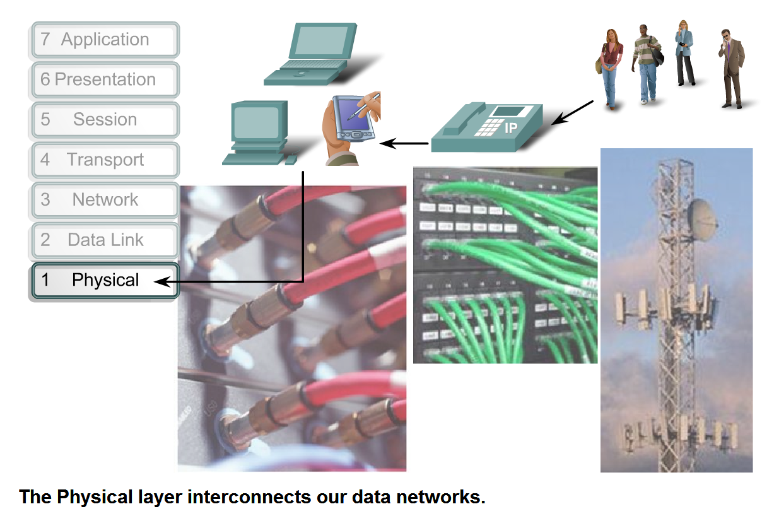
COMPUTER NETWORKS
Purpose of Physical Layer

Slide 80
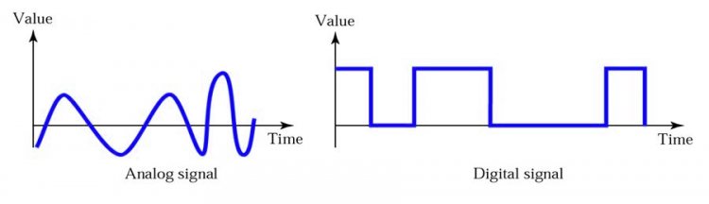
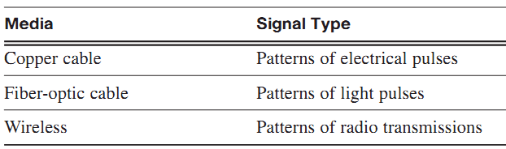
COMPUTER NETWORKS
Physical Layer Services
The role of Physical Layer is to:
encode the binary digits that represent data link layer frames into signals
to transmit and receive these signals cross the physical media
copper wires, optical fiber, and wireless that connect network devices.
Physical medium - conduct a signal in the form of voltage, light, or radio waves from one device to another.
Analog signal – continuous-valued (amplitudes, frequencies)
Digital signal – discrete-valued (0s & 1s)

Slide 81
COMPUTER NETWORKS
Physical Layer Services
The delivery of frames across the local media requires the following physical layer elements:
The physical media and associated connectors
A representation of bits on the media
Encoding of data and control information
Transmitter and receiver circuitry on the network devices
Components to understand Physical Layer functions includes:
Physical components
Encoding
Signaling
Physical Layer Devices
Hub
Repeater
Modem
Cables
Network Adapters

Slide 82
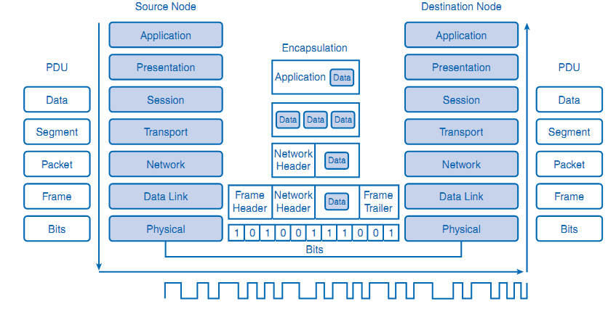
COMPUTER NETWORKS
Physical Layer Services
Physical Layer Encoding

Slide 83
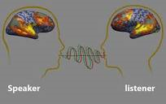
COMPUTER NETWORKS
Physical Layer – Human Analogy
A person wants to communicate an idea:
processes an abstract thought into words (signaling) ->
encoded into speech sounds (encoding) ->
sent out through the medium of air (physical).
At the other end:
the receiver interprets the signal of sound,
recognizes patterns in the sound that denote words &
then processes the meaning of the words into the original idea

Slide 84
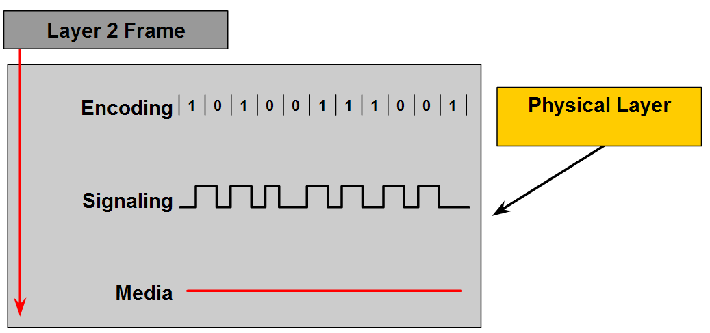
COMPUTER NETWORKS
Physical Layer Principles

Slide 85
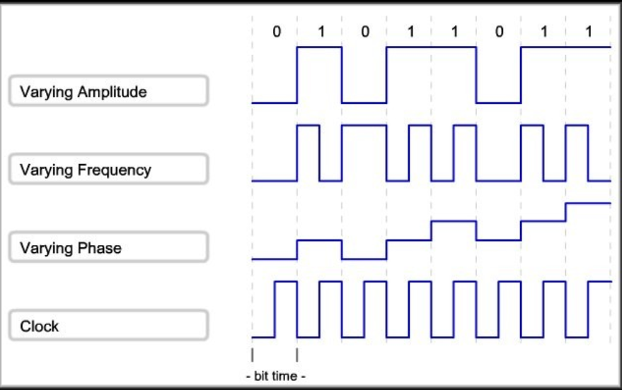
COMPUTER NETWORKS
Signalling Bits for the Media

Slide 86
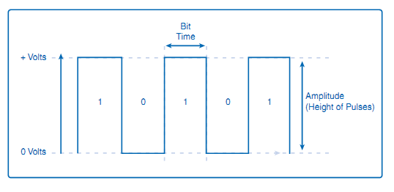
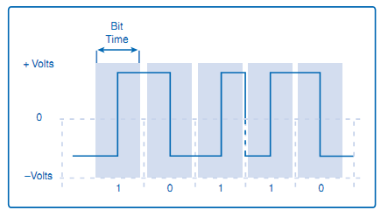
COMPUTER NETWORKS
Signalling Methods
NRZ (Non Return to Zero) Encoding – A low voltage being 0 and a higher voltage representing a 1.
Manchester Encoding
A voltage change from low to high within the bit time represents a 1.
A voltage drop within the bit time from a high to a low voltage represents a 0.

Slide 87
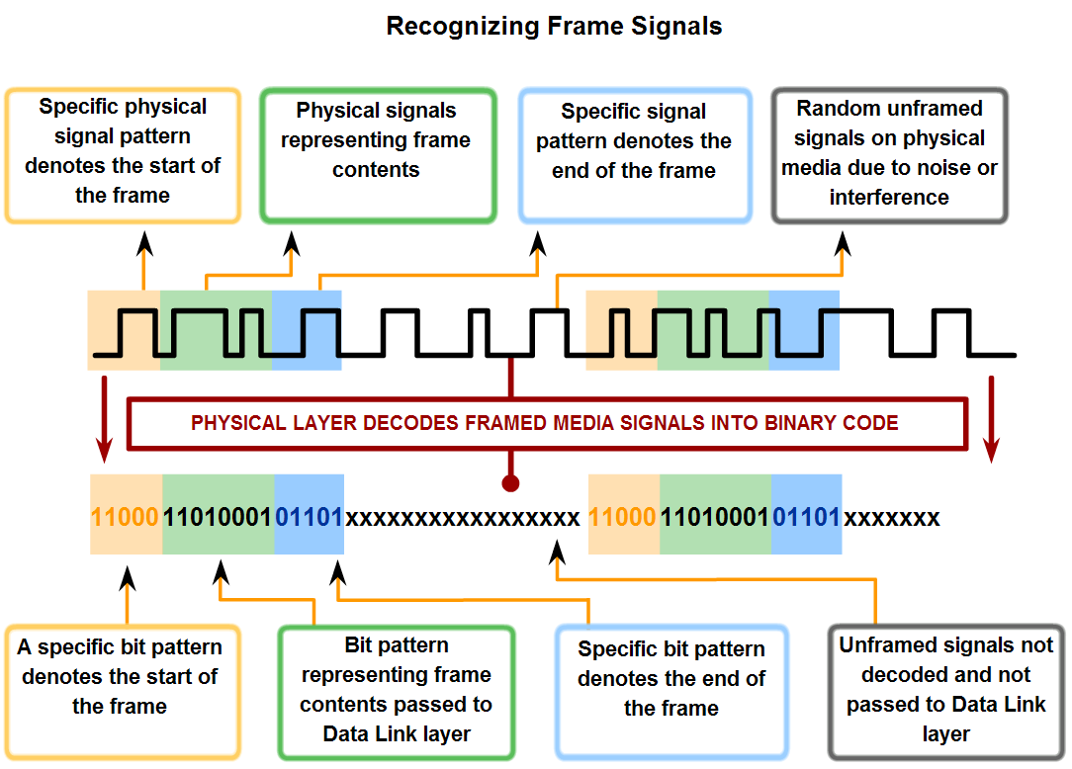
COMPUTER NETWORKS
Physical Layer – Signalling and Encoding

Slide 88
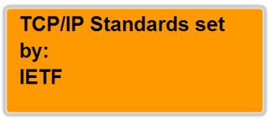
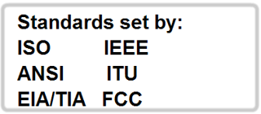
COMPUTER NETWORKS
Physical Layer Standards
Some of the key organizations:
The International Organization for Standardization (ISO)
The Institute of Electrical and Electronics Engineers (IEEE)
The American National Standards Institute (ANSI)
The International Telecommunication Union (ITU)
The Electronics Industry Alliance/Telecommunications Industry Association (EIA/TIA)
National telecommunications authorities such as the Federal Communications Commission (FCC) in the United States

Slide 89
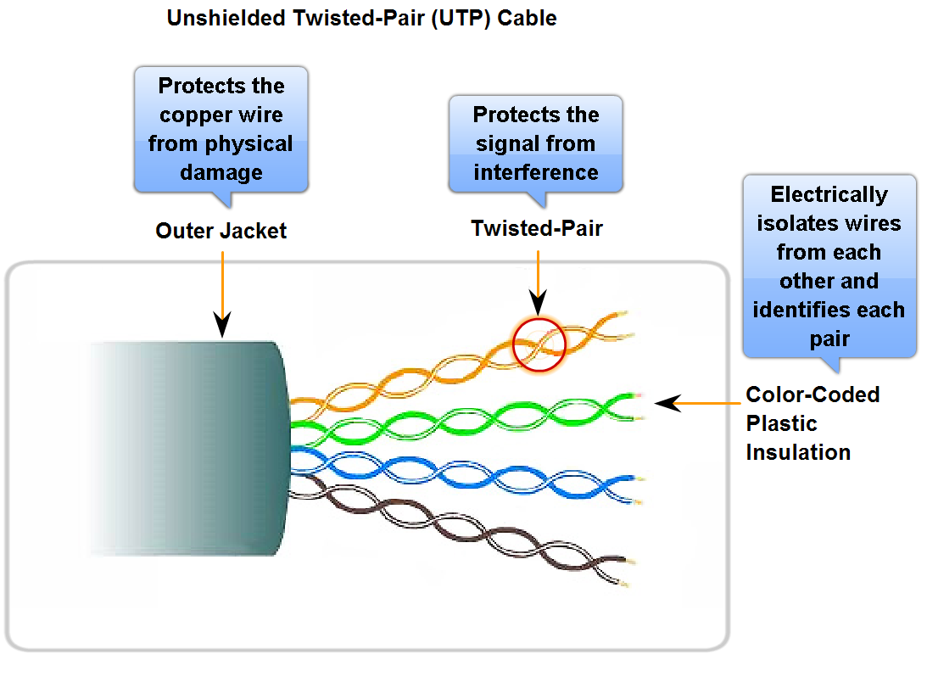
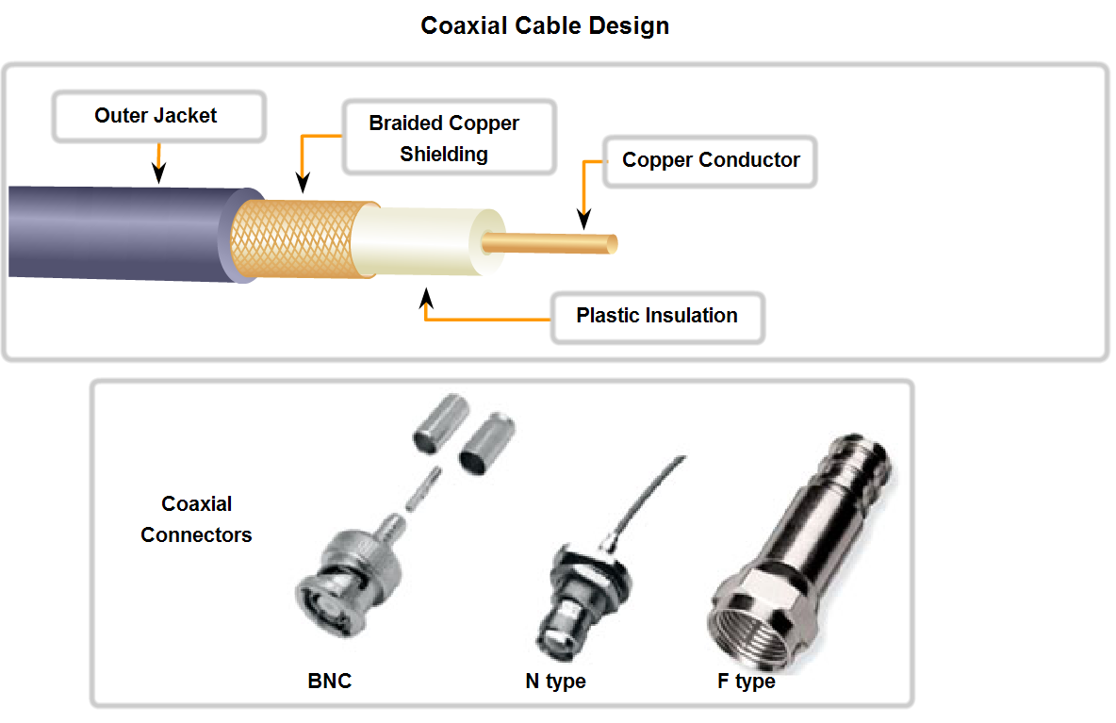
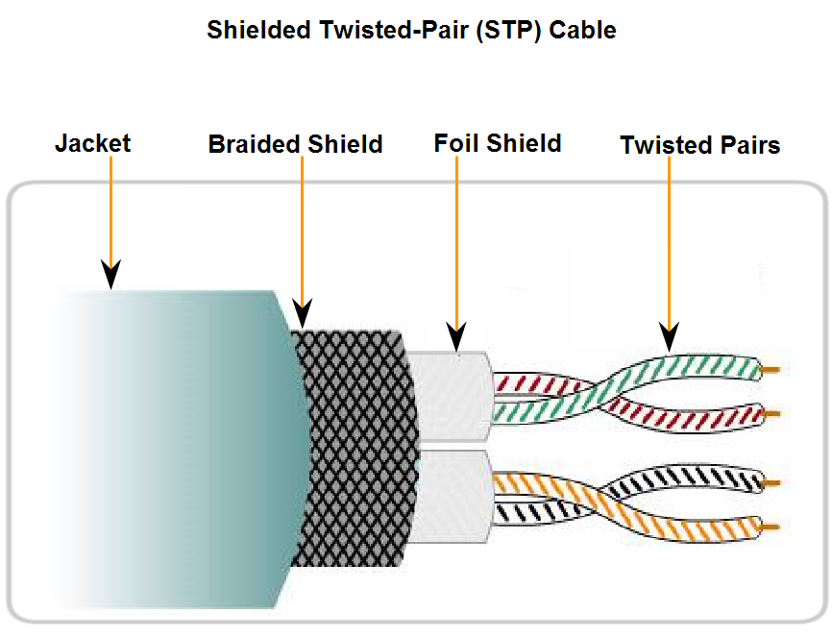
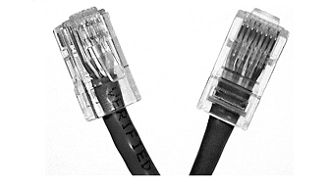
COMPUTER NETWORKS
Transmission Media
light
cladding
jacket
core

Slide 90
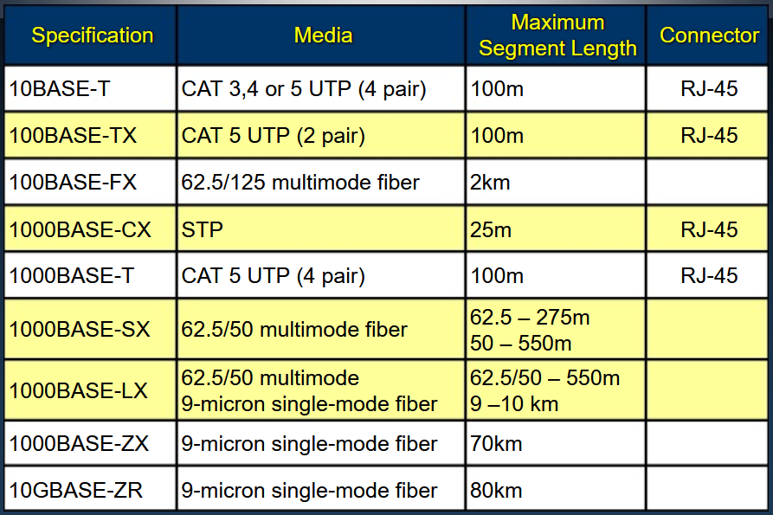
COMPUTER NETWORKS
Types of Physical Transmission Media

Slide 91
COMPUTER NETWORKS
Unit – 4 Link Layer and LAN Roadmap
Introduction
Error detection, correction
Multiple access protocols
Switched LANs
addressing, ARP
Ethernet
switches
A day in the life of a web request
Physical layer
Wireless LANs: IEEE 802.11

Slide 92














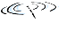


COMPUTER NETWORKS
Elements of a Wireless Network
wired network
infrastructure

Slide 93
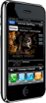


COMPUTER NETWORKS
Elements of a Wireless Network
wireless hosts
laptop, smartphone, IoT
run applications
may be stationary (non-mobile) or mobile
wireless does not always mean mobility!
wired network
infrastructure

Slide 94

COMPUTER NETWORKS
Elements of a Wireless Network
base station
typically connected to wired network
relay - responsible for sending packets between wired network and wireless host(s) in its “area”
e.g., cell towers, 802.11 access points
wired network
infrastructure

Slide 95
COMPUTER NETWORKS
Elements of a Wireless Network
wireless link
typically used to connect mobile(s) to base station, also used as backbone link
multiple access protocol coordinates link access
various transmission rates and distances, frequency bands
wired network
infrastructure

Slide 96
COMPUTER NETWORKS
Characteristics of Selected Wireless Links
14 Gbps
802.11ax (WiFi-6)
10 Gbps
5G
2 Key Areas:
Coverage area &
Link rate
3.5 Gbps
802.11ac (WiFi-5)
802.11 af,ah (White-Fi)
600 Mbps
802.11n (WiFi-4)
4G LTE
54 Mbps
802.11g (WiFi-3)
11 Mbps
802.11b (WiFi-1)
2 Mbps
Bluetooth
Indoor
Outdoor
Midrange
outdoor
Long range
outdoor
10-30m
50-200m
200m-4Km
4Km-15Km

Slide 97
COMPUTER NETWORKS
Elements of a Wireless Network
infrastructure mode
base station connects mobiles into wired network
handoff: mobile changes base station providing connection into wired network
wired network
infrastructure

Slide 98
COMPUTER NETWORKS
Elements of a Wireless Network
ad hoc mode
no base stations
nodes can only transmit to other nodes within link coverage
nodes organize themselves into a network: routing, address assignment, DNS-like name translation, and more.

Slide 99
COMPUTER NETWORKS
Wireless network taxonomy
single hop
multiple hops
host connects to base station (WiFi, cellular) which connects to larger Internet. Eg: 4G LTE
host may have to relay through several wireless nodes to connect to larger
Internet: mesh net
infrastructure
(e.g., APs)
no base station, no connection to larger Internet.
eg: Bluetooth, ad hoc nets
no base station, no connection to larger Internet. May have to relay to reach other.
eg: MANET, VANET
infrastructure less

Slide 100
COMPUTER NETWORKS
IEEE 802.11 Wireless LAN (WiFi)
IEEE 802.11 standard | Year | Max data rate | Range | Frequency
802.11b | 1999 | 11 Mbps | 30 m | 2.4 Ghz
802.11g | 2003 | 54 Mbps | 30m | 2.4 Ghz
802.11n (WiFi 4) | 2009 | 600 | 70m | 2.4, 5 Ghz
802.11ac (WiFi 5) | 2013 | 3.47Gpbs | 70m | 5 Ghz
802.11ax (WiFi 6) | 2020 (exp.) | 14 Gbps | 70m | 2.4, 5 Ghz
802.11af | 2014 | 35 – 560 Mbps | 1 Km | unused TV bands (54-790 MHz)
802.11ah | 2017 | 347Mbps | 1 Km | 900 Mhz
all use CSMA/CA for multiple access, and have base-station and ad-hoc network versions

Slide 101




COMPUTER NETWORKS
The 802.11 LAN architecture
Internet
wireless host communicates with base station
base station = access point (AP)
Basic Service Set (BSS) (aka “cell”) in infrastructure mode contains:
wireless hosts
access point (AP): base station
ad hoc mode: hosts only
switch
or router
BSS 1
BSS 2

Slide 102
COMPUTER NETWORKS
802.11: Channels, Association
spectrum divided into channels at different frequencies
AP assigns Service Set ID (SSID)
AP admin chooses frequency for AP (2.4 GHz to 2.4835 GHz)
interference possible: channel can be same as that chosen by neighboring AP! – WiFi Jungle
arriving host: must associate with an AP
scans channels, listening for beacon frames containing AP’s name (SSID) and MAC address
selects AP to associate with
then may perform authentication
then typically run DHCP to get IP address in AP’s subnet
BSS

Slide 103
COMPUTER NETWORKS
802.11 active/passive scanning
BBS 1
BBS 2
BBS 1
BBS 2
1
1
AP 2
AP 1
1
AP 2
2
2
2
AP 1
3
3
4
H1
H1
passive scanning:
beacon frames sent from APs
association Request frame sent: H1 to selected AP
association Response frame sent from selected AP to H1
active scanning:
Probe Request frame broadcast from H1
Probe Response frames sent from APs
Association Request frame sent: H1 to selected AP
Association Response frame sent from selected AP to H1

Slide 104



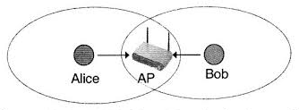

COMPUTER NETWORKS
IEEE 802.11: multiple access
802.11’s link-layer acknowledgment scheme!!!
avoid collisions: 2⁺ nodes transmitting at same time
802.11: CSMA - sense before transmitting
don’t collide with detected ongoing transmission by another node
802.11: no collision detection!
difficult to sense collisions: high transmitting signal, weak received signal due to fading
can’t sense all collisions in any case: hidden terminal, fading
goal: avoid collisions: CSMA/CollisionAvoidance
A
B
C
C
B
A’s signal
strength
C’s signal
strength
A
space

Slide 105
COMPUTER NETWORKS
IEEE 802.11 MAC Protocol: CSMA/CA
Distributed Inter-frame Space (DIFS);
802.11 sender
1 if sense channel idle for DIFS then
transmit entire frame (no CD)
sender
receiver
DIFS
2 if sense channel busy then
start random backoff time
timer counts down while channel idle
transmit when timer expires
if no ACK, increase random backoff interval, repeat 2
data
SIFS
802.11 receiver
if frame received OK
return ACK after SIFS (ACK needed due to hidden terminal problem)
ACK
Short Inter-frame Spacing (SIFS)

Slide 106
COMPUTER NETWORKS
Avoiding Collisions (more)
idea: sender “reserves” channel use for data frames using small reservation packets
sender first transmits small request-to-send (RTS) packet to BS using CSMA
RTSs may still collide with each other (but they’re short)
BS broadcasts clear-to-send CTS in response to RTS
CTS heard by all nodes
sender transmits data frame
other stations defer transmissions

Slide 107

COMPUTER NETWORKS
Collision Avoidance: RTS-CTS exchange
A
B
AP
RTS(A)
RTS(B)
reservation collision
RTS(A)
CTS(A)
CTS(A)
time
DATA (A)
defer
ACK(A)
ACK(A)

Slide 108
COMPUTER NETWORKS
802.11 frame: addressing
2
2
6
6
6
2
6
0 - 2312
4
frame
control
duration
address
1
address
2
address
3
seq
control
address
4
payload
CRC
Address 1: MAC address of wireless host or AP to receive this frame
Address 4: used only in ad hoc mode
Address 3: MAC address of router interface to which AP is attached
Address 2: MAC address
of wireless host or AP
transmitting this frame

Slide 109
COMPUTER NETWORKS
802.11 frame: addressing
Internet
H1
R1
802.3 Ethernet frame
R1 MAC addr
H2 MAC addr
MAC dest addr
MAC source addr
AP MAC addr
H1 MAC addr
R1 MAC addr
address 1
address 2
address 3
802.11 WiFi frame

Slide 110
COMPUTER NETWORKS
802.11 frame: addressing
duration of reserved
transmission time (RTS/CTS)
frame sequence # (for reliable data transfer)
2
2
6
6
6
2
6
0 - 2312
4
frame
control
duration
address
1
address
2
address
3
seq
control
address
4
payload
CRC
2
2
4
1
1
1
1
1
1
1
1
protocol
version
type
subtype
to
AP
from
AP
more
frag
retry
power
mgt
more
data
WEP
rsvd
frame type (RTS, CTS, ACK, data)

Slide 111
COMPUTER NETWORKS
802.11: mobility within same subnet
H1 remains in same IP subnet: IP address can remain same
switch: which AP is associated with H1?
self-learning (Ch. 6): switch will see frame from H1 and “remember” which switch port can be used to reach H1
BBS 1
H1
BBS 2

Slide 112

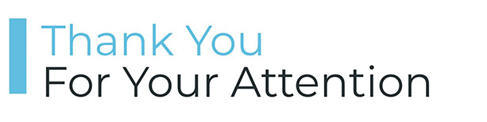
COMPUTER NETWORKS
Suggested Readings

Slide 113

THANK YOU
TEAM NETWORKS
Department of Computer Science and Engineering

